Slide 1
Track module 1 Basics of Machine Learning in Python Block 6
Ekaterina Golubeva
21.11.22

Slide 2
Image segmentation using traditional ML
Feature extraction
Creating Ml model
Feature importances
Save the result (pickle)
Segmentation

Slide 3
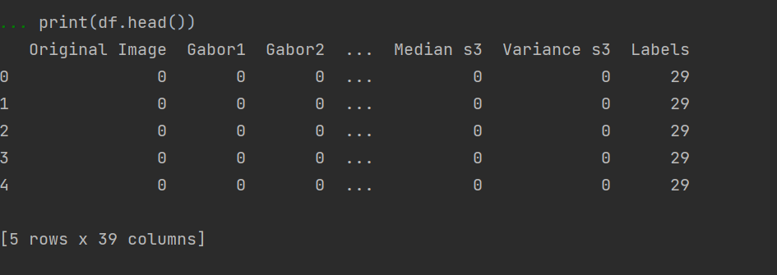
Feature extraction
Creating a dataframe with features, original pixels and labels.

Slide 4
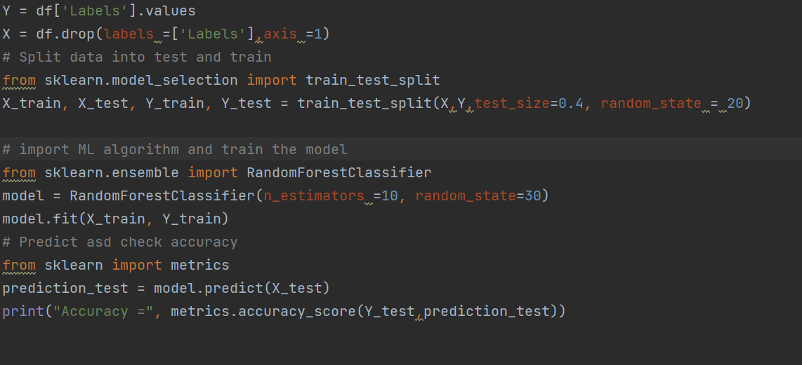
Training Random Forest Classifier
After splitting the datasets, create a model with RFClassifier, fit it on the training test and predict and compare with the test set.

Slide 5
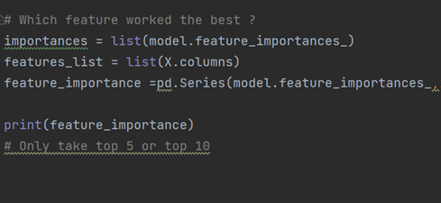
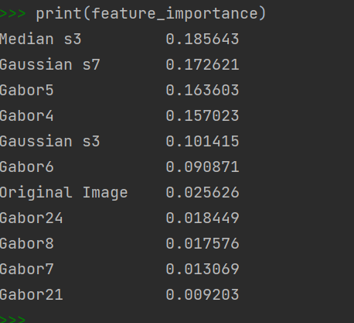
Feature Ranking

Slide 6
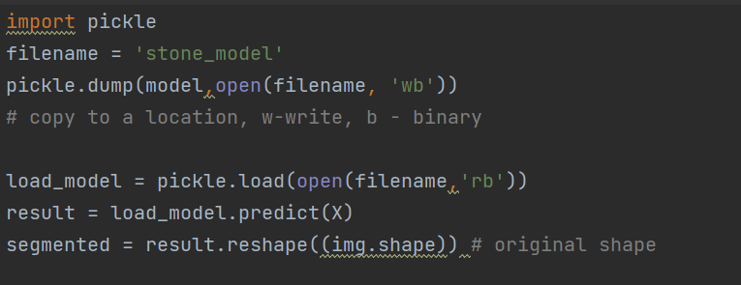
Pickling the model
Store the model and use it for future purposes

Slide 7
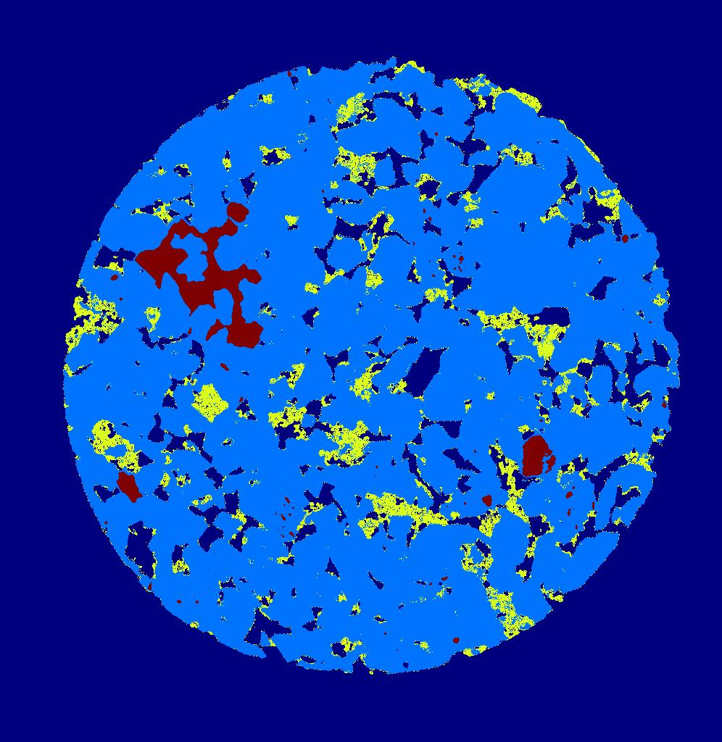
USE THE SAVED MODEL TO PREDICT

Slide 8
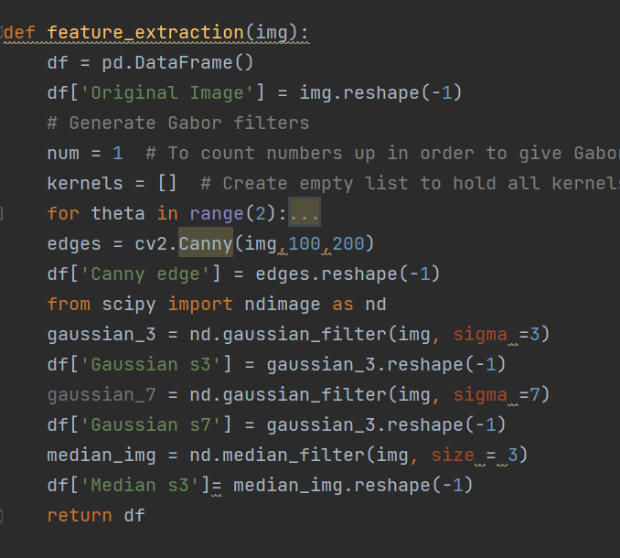
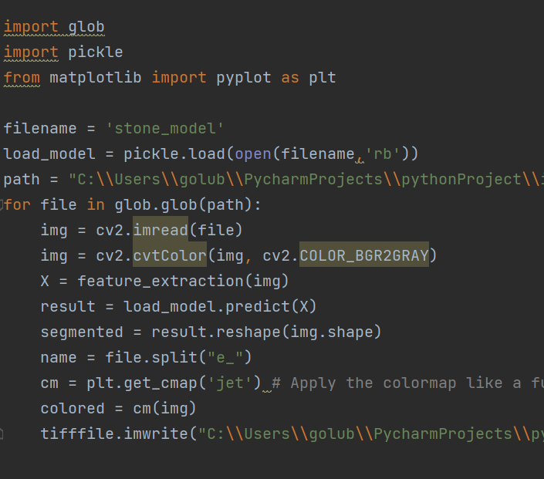
Predict on multiples images

Slide 9
Further exploration
Try with my own image (segment/label first)
Try with https://www.apeer.com/home/ : tool for image labeling
Training on multiple images

